Slide 1
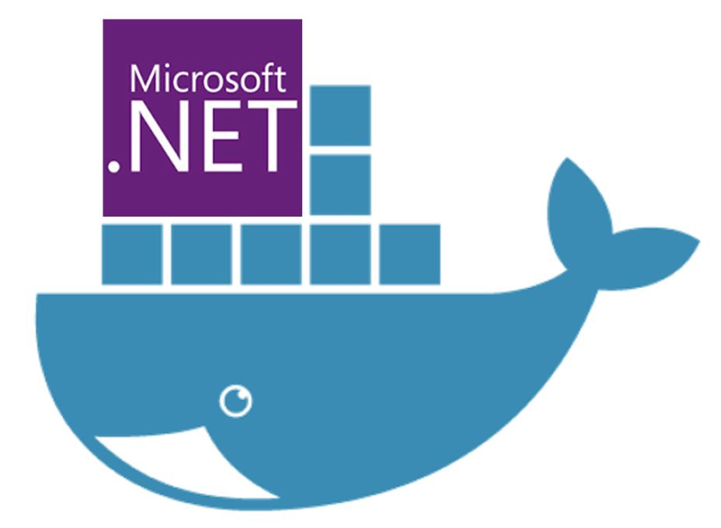
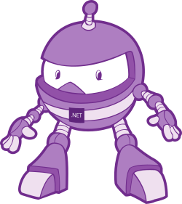
Dockerising .Net applications
Simplifying software delivery for .Net Devs (even if your boss says you can’t use Docker!)
Slides & code available on Github: https://bit.ly/2EO2lth (case sensitive!)

Slide 2

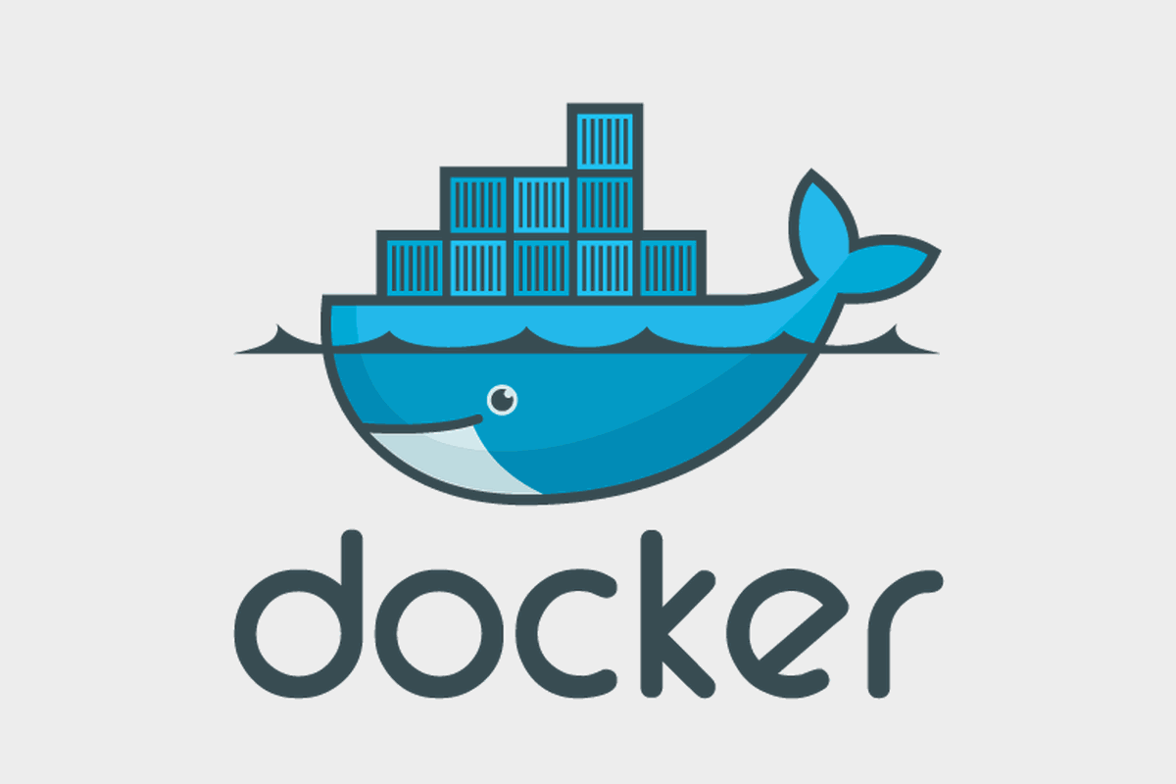
What is Docker?

Slide 3
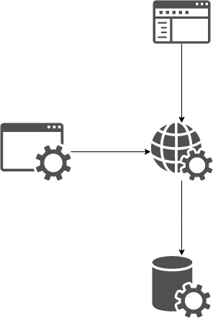
Context: Our Application Stack
Web
Front end
Web
API
Automated
Tests
Database

Slide 4


Setting up you Dev Environment
==

Slide 5
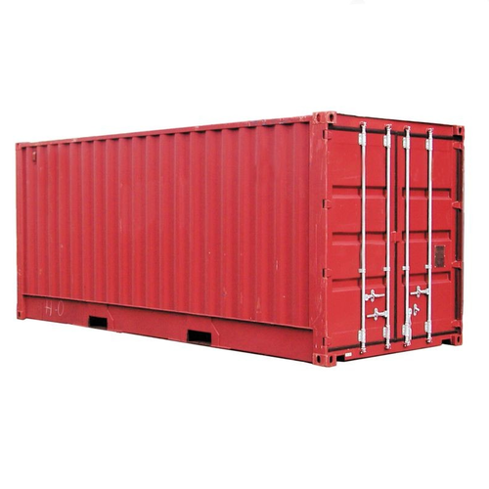

Same Stack, but running in containers

Slide 6
Demo 1

Slide 7
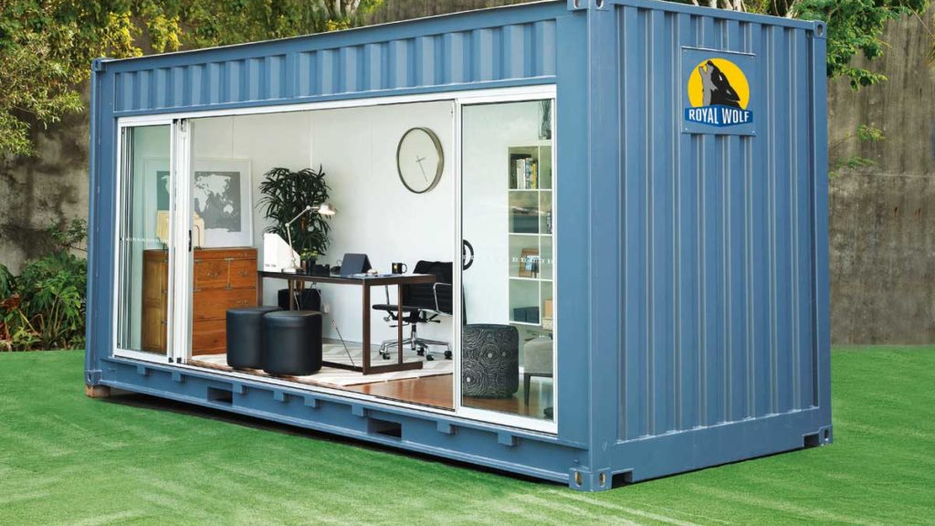
Use cases for Docker

Slide 8

QA / Testers

Slide 9

UI Devs

Slide 10

Devs

Slide 11
Context Switching
Application Y:
MVC
Web API
SQL Server
Application X:
React
Node.js
Mongo

Slide 12
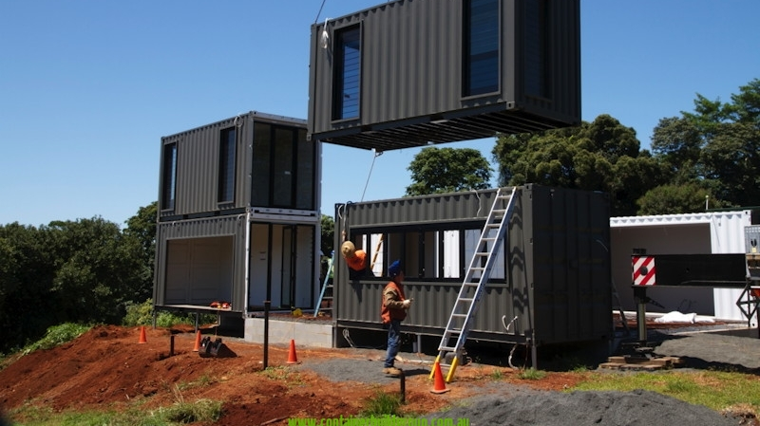
Building Containers
Containers are running instances of Images
Images are created from a Dockerfile
Dockerfiles contain instructions of how to build you application
Notes:
Ok, so we now know what Docker is and have an idea of what it can do for us once we have our apps in Containers.
Now we need to know how to get our app inside a container?
You spin up a Container instance from an Image. (note the language I used there - spin up a Container Instance or Instances, from an image)
A Container is a runtime instance of an image, and you can have many instances, for example, in a load balanced environment.
An image is an executable package that includes everything needed to run an application-
You define an image using a Dockerfile, which contains all the instructions for creating your image.
Its essentially the blue prints for what every Container instance created from it will look like and behave.

Slide 13
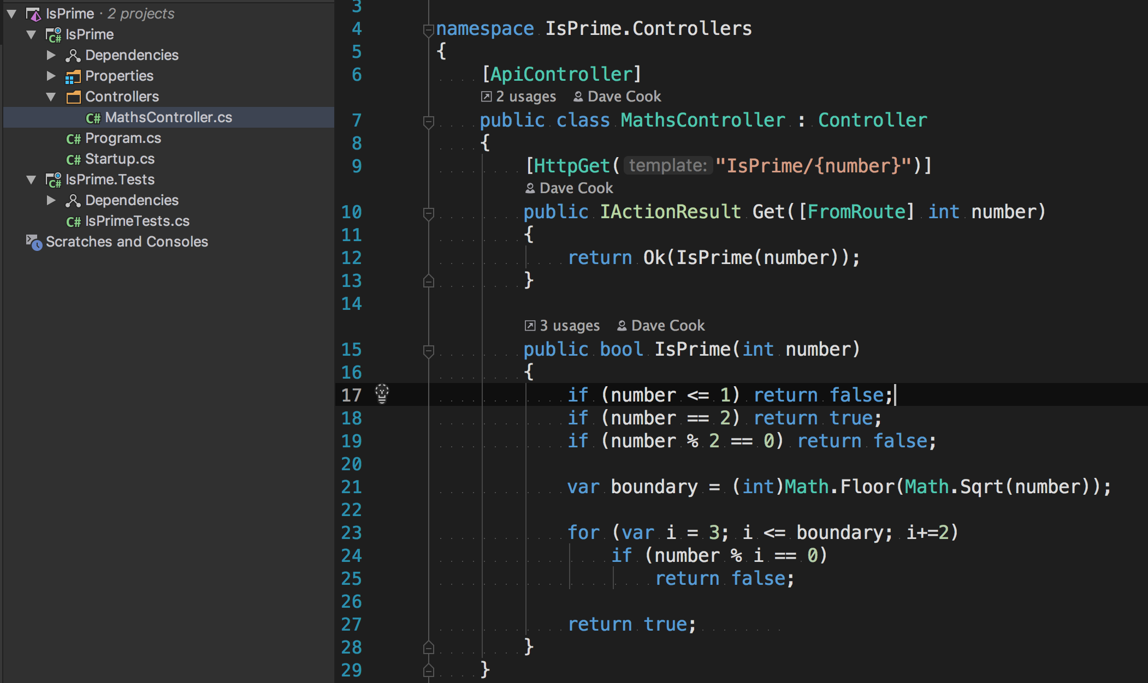
Context: Our Sample service
Notes:
In a moment we will have a look at our first DockerFile
But before that, let me first introduce the application that we are going to be Dockerising: A really simple web api project, running on .Net Core.
This provides a single HTTP endpoint to make a get request, and returns a response indicating if the supplied parameter is a prime number or not.
On the left you can see the solution structure – there is a single project folder called IsPrime which contains the WebApi service, and a single test project called IsPrime.Tests, with a few tests to run over the code on the right.
The code in the service is super simple - I’ve omitted things like error handling and Dependency injection for clarity.
Something you can’t see here is that this service is configured in Program.cs to run on Port 9021

Slide 14
Our Dockerfile

Slide 15
Build an Image
docker build -t isprime_dotnetcore:1 .

Slide 16
Demo – Build an Image
Notes:
docker build -t isprime_dotnetcore:1 .

Slide 17
Start a Container
docker run -p 80:9021 isprime_dotnetcore:1

Slide 18
Demo – Start a Container
Notes:
docker run -p 80:9021 isprime_dotnetcore:1

Slide 19
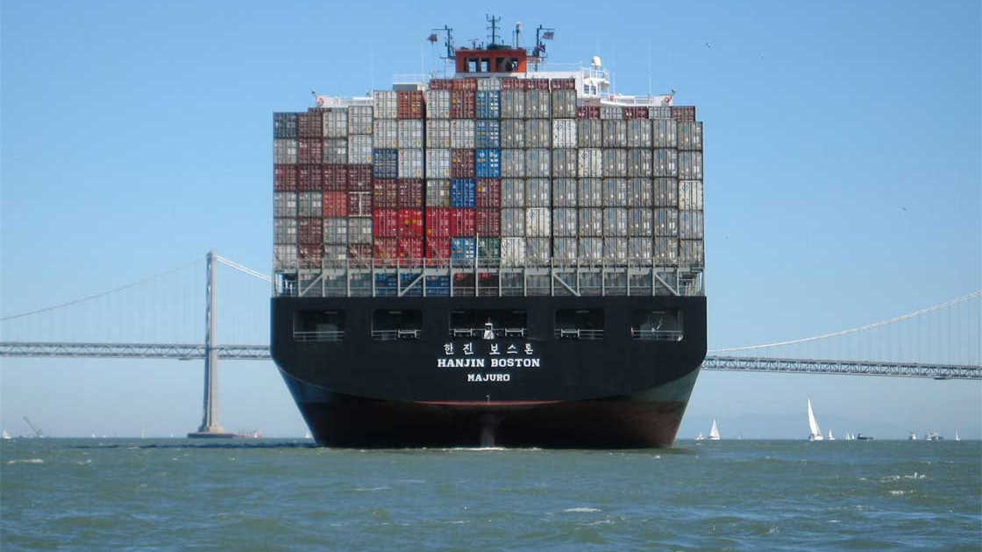
Docker Compose

Slide 20
Docker Compose YML

Slide 21

Docker in Production

Slide 22
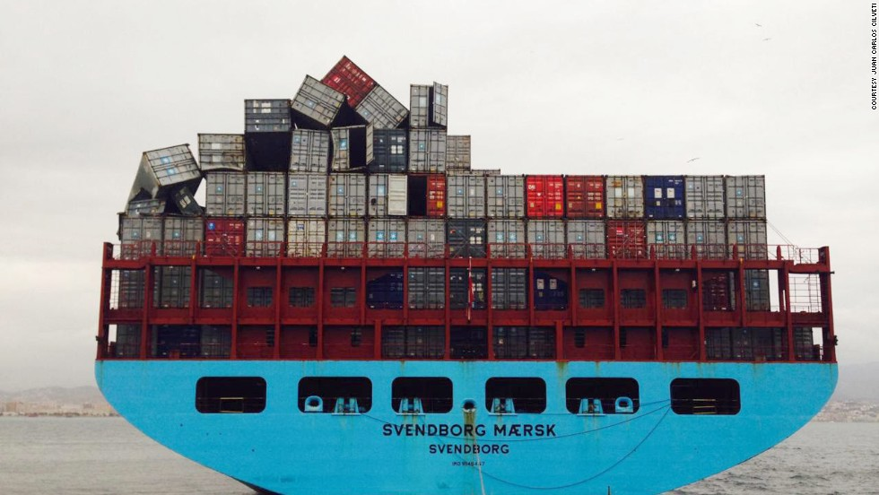
New Challenges

Slide 23

Quick Plug, then Questions
www.dddeastanglia.com/

Slide 24



Questions?
https://medium.com/@dcook_net
@dcook_net
https://github.com/dcook-net/
Slides & code : https://bit.ly/2EO2lth

Slide 25
Resources
Exploring Net Core Docker Files - Andrew Lock
Docker for .Net Developers (7 part Series) - Steve Gordon
Announcing the Microsoft Container Registry - Rich Lander
How To Build a Smaller Docker Image – Medium
What's wrong with Latest and The misunderstood latest tag
Play with Docker Classroom - Dockers Labs
https://docs.docker.com/engine/examples/dotnetcore/

